Slide 1
Interface In Java

Slide 2
AGENDA :
INTERFACE IN JAVA
WHY DO WE NEED A JAVA INTERFACE?
HOW TO DECLARE A JAVA INTERFACE?
WHAT IS MULTIPLE INHERITANCE?
HOW TO DECLARE A MULTIPLE INHERITANCE?
WHAT IS INTERFACE INHERITANCE?
HOW TO DECLARE A INTERFACE INHERITANCE?
DIFFERENCE BETWEEN ABSTRACT CLASS AND INTERFACE IN JAVA
DIFFERENCE BETWEEN CLASS AND INTERFACE IN JAVA
ADVANTAGES AND DISADVANTAGES OF JAVA INTERFACE
KEY POINTS
CONCLUSION

Slide 3
INTERFACE IN JAVA
An interface in Java is a blueprint of a class. It has static constants and abstract methods.
The interface in Java is a mechanism to achieve Abstraction. There can be only abstract methods in the Java interface, not method body. It is used to achieve abstraction and multiple inheritance in Java.
In other words, you can say that interfaces can have abstract methods and variables. It cannot have a method body.It cannot be instantiated just like the abstract class.
Since Java 8, we can have default and static methods in an interface. Since Java 9, we can have private methods in an interface.
Interface is an abstract type that is used to specify a behaviour that all the classes must implement. interfaces are similar to abstract classes, but differ in their functionality.
In interface, none of the methods are implemented means interface defines methods without body. But it contains final variables, which must be initialized with values.
a class extends another class, an interface extends another interface, but a class implements an interface.

Slide 4
WHY DO WE NEED A JAVA INTERFACE?
It is used to achieve abstraction.
1
2
By interface, we can support the functionality of multiple inheritance.
3
It can be used to achieve loose coupling
4
Hiding the implement methods

Slide 5
HOW TO DECLARE A JAVA INTERFACE:
SYNTAX TO DECLARE AN INTERFACE:
interface<interface-name>{
//declare constant fields
//declare methods that abstract
//by default.
}

Slide 6
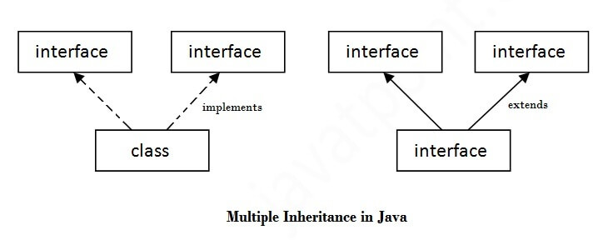
Multiple Inheritance:
If a class implements multiple interfaces, or an interface extends multiple interfaces, it is known as multiple inheritance.
Syntax of Multiple inheritance:
public interface1{
//Method1
}
public interface2 {
//Method2
}
Class ABC implements interface1,interface2{
}

Slide 7
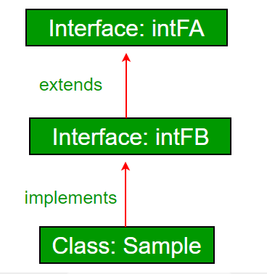
Interface Inheritance:
A class can extends another class and/ can implement one and more than one interface.
An Interface can extend other
interface.
Syntax of Interface Inheritance:
public interface A{
//Method1
}
public interface B extends A{
//Method2
}

Slide 8
Abstract Class vs Interface in Java :
Parameters | Abstract class | Interface
1. Keyword Used | Abstract | interface
2.Type of Variable | Static and Non-Static | Static
3.Access Modifiers | All access modifiers | Only Public access modifier
4.Speed | Fast | Slow
5.When to use | To avoid independence | For Future Enhancement

Slide 9
Difference between class & Interface in java:
.
Class
Interface
Class can instantiate variable & create object
Interface can’t instantiate variable & create an object
Class can contain concrete methods
The interface can’t contain concrete methods.
The access specifiers used with classes are private, protected and public
In interface only one public specifier is used

Slide 10
Advantages of Interface:
Through interface we can implement multiple inheritance in java.
Interfaces function to break up the complex designs and clear the dependencies between objects.
Interfaces makes your application loosely coupled.

Slide 11
Disadvantages of Interface:
Java interfaces are slower and more limited than other ones.
Interface should be used multiple number of times else there is hardly any use of having them.

Slide 12
Key Points:
Extending an interface:
An interface can extend any interface but cannot implement it.
A class can implement any number of interfaces.
If there are two or more same methods in two interfaces and a class implements both interfaces, implementation of the method once is enough.
A class cannot implement two interfaces that have methods with same name but different return type.
Variable names conflicts can be resolved by interface name.

Slide 13
Conclusion:
An interface in java is a blueprint of a class and contains static constants and abstract methods.
Interfaces in java helps achieve polymorphism and abstraction. They also make it possible to implement Multiple inheritance in java.
If a class contains a method not implemented by all its child classes, abstract that method into a different interface and make the child classes implement that interface.

Slide 14
See You With Program Now!!!

